Slide 1
Weekly Report
Wensheng Cheng
2022.2.7-2.14

Slide 2
Last discussion
Regard the false positive filtering problem as outlier detection, which is a specific study field in data science
Try feature similarity to find FP
Conclusion: yes, even some high score FP could be removed, but also some TPs are removed wrongly.
Try spatial/position relation to find FP
Conclusion: yes, this could remove some FP which has similar feature with others, but this need to be used carefully, since some high score TP could be removed wrongly.

Slide 3
This week
Explore why the baseline model can’t capture some objects visually similar to the template.
The object is missed at which stage, backbone, QG-RPN, or QG-RCNN?
Conclusion: RPN. A typical example is the airplane img.
Backbone influence on the problem, Swin or ResNet?
Conclusion: Not uniform. Swin gets better results on some sequences than ResNet, but ResNet also gets better results on other sequences.
Thoughts: SOT pretrained RPN is bad for our task, since it decreases the response of some objects similar with the template, try the one pretrained on detection task.

Slide 4

Feature Map after Baseline Backbone
I directly conv the template’s backbone feature with the image’s backbone feature, and get results below.

Slide 5
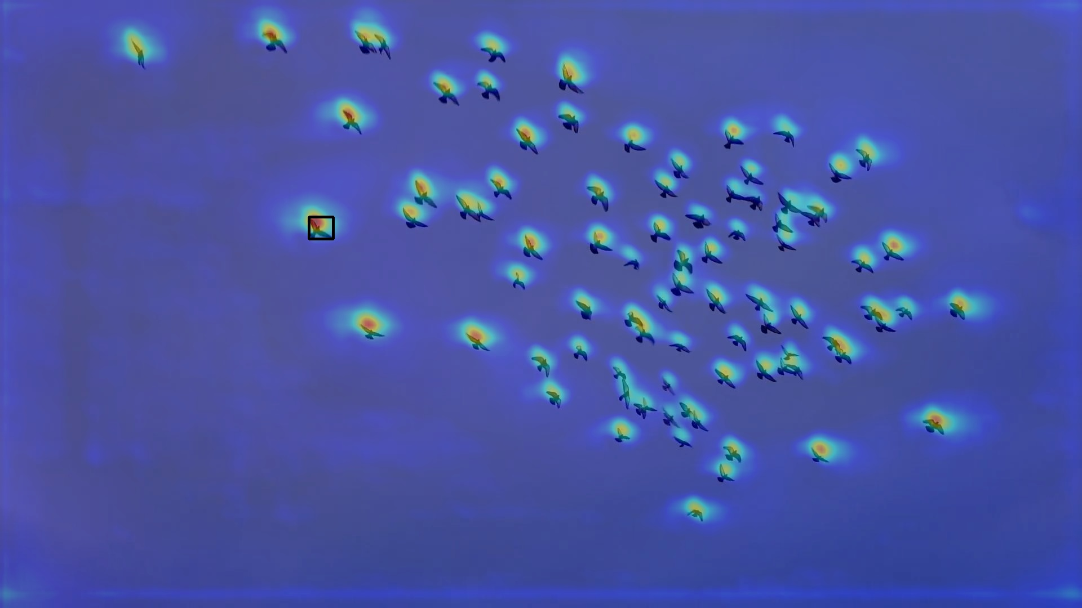
Feature Map after Baseline Backbone

Slide 6

Feature Map after Baseline Backbone

Slide 7
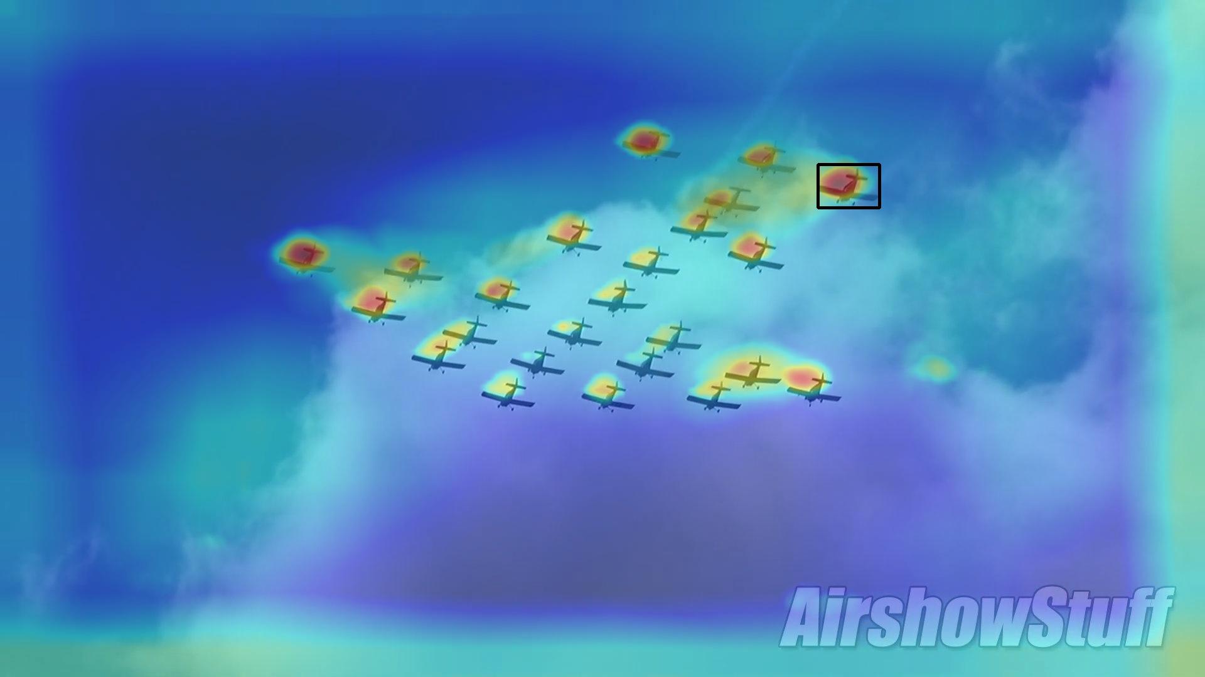
Feature Map after Baseline QG-RPN
Below is the result of QG-RPN output.

Slide 8
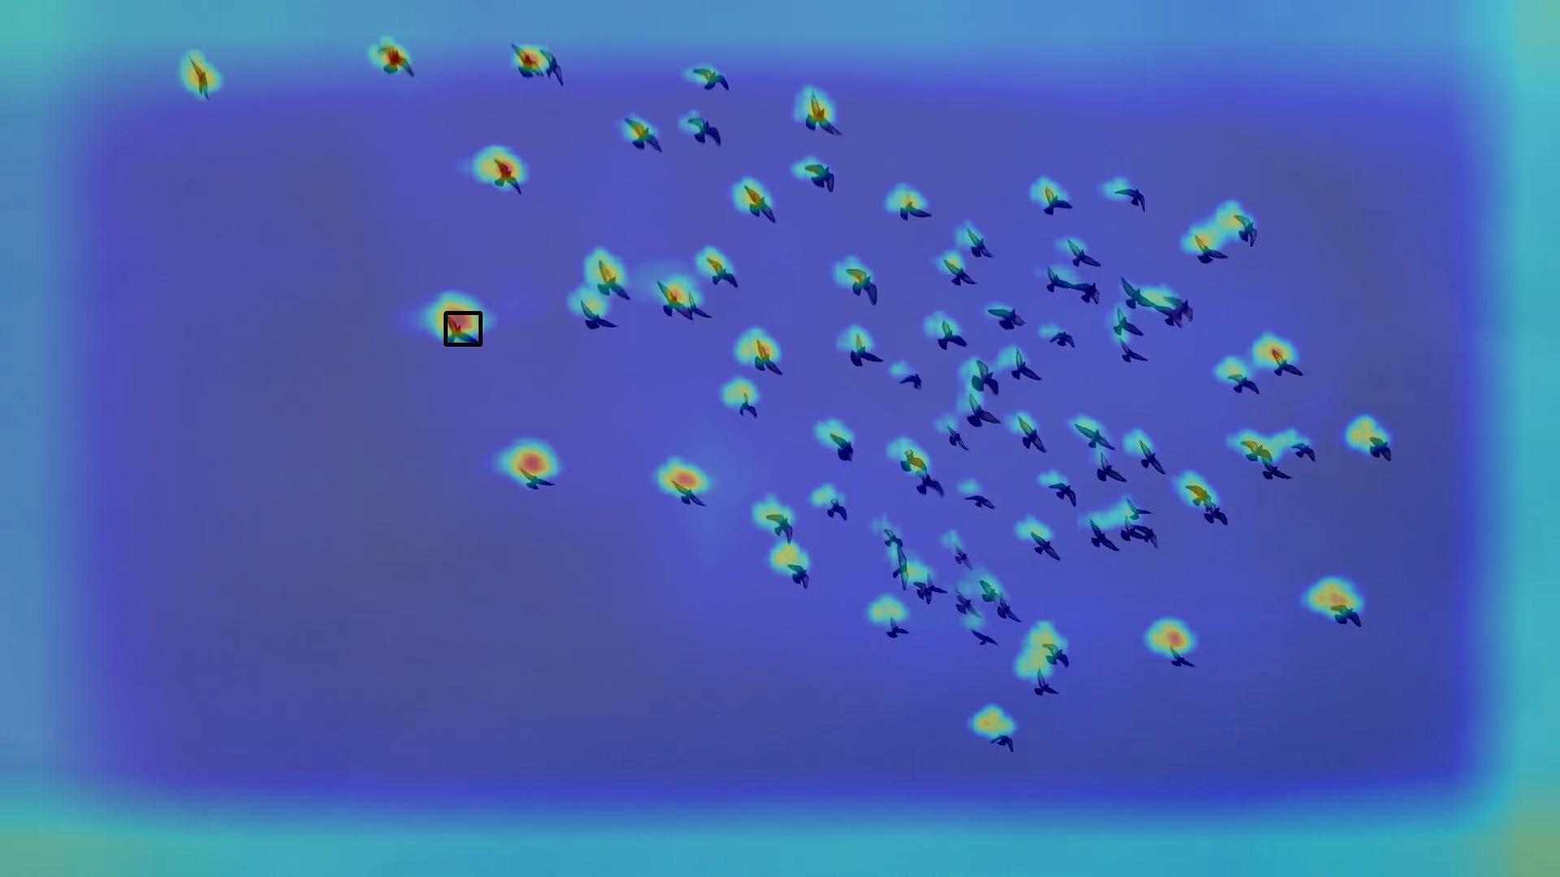
Feature Map after Baseline QG-RPN
Below is the result of QG-RPN output.

Slide 9

Feature Map after Baseline QG-RPN
Below is the result of QG-RPN output.

Slide 10
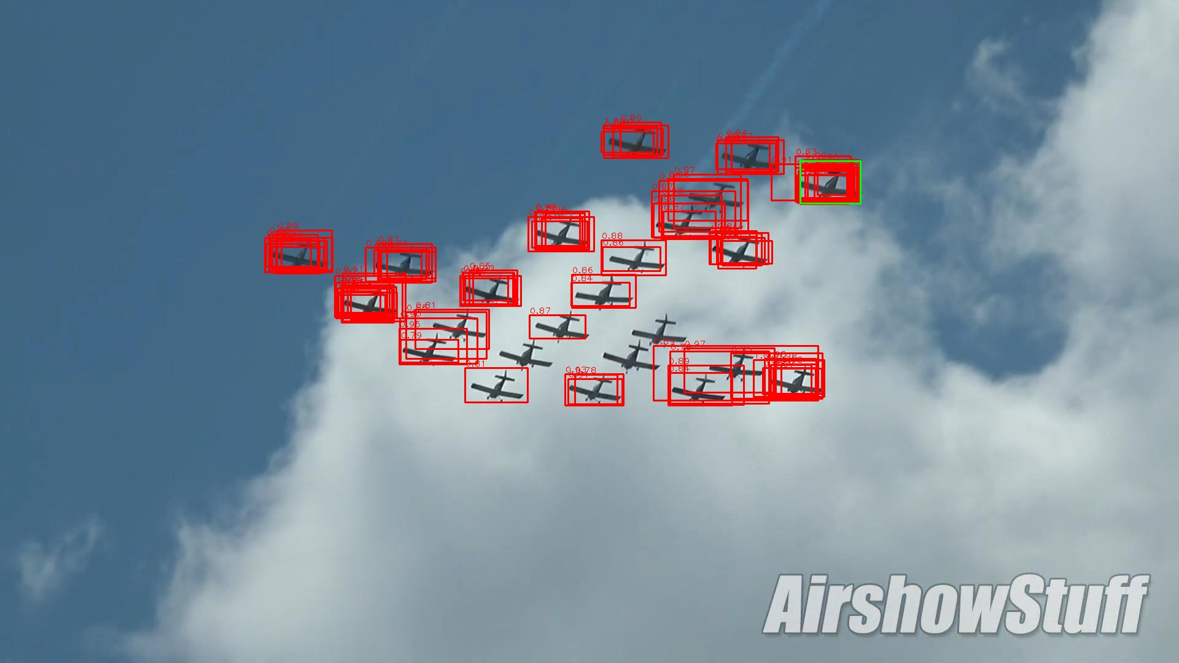
Proposals of Baseline QG-RPN
Below shows the top 100 proposals of QG-RPN output.

Slide 11
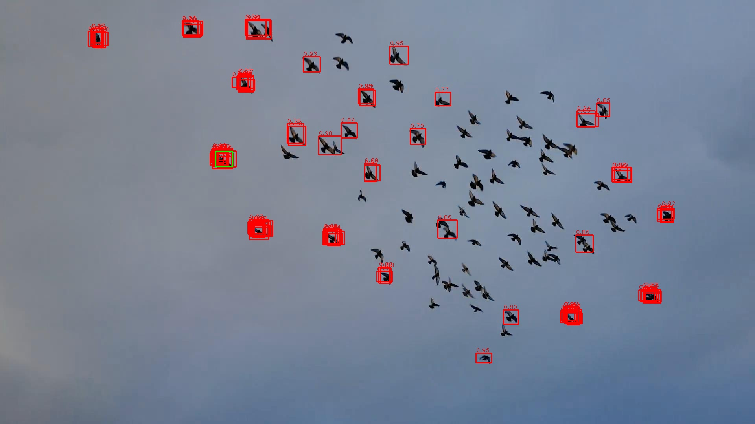
Proposals of Baseline QG-RPN
Below shows the top 100 proposals of QG-RPN output.

Slide 12
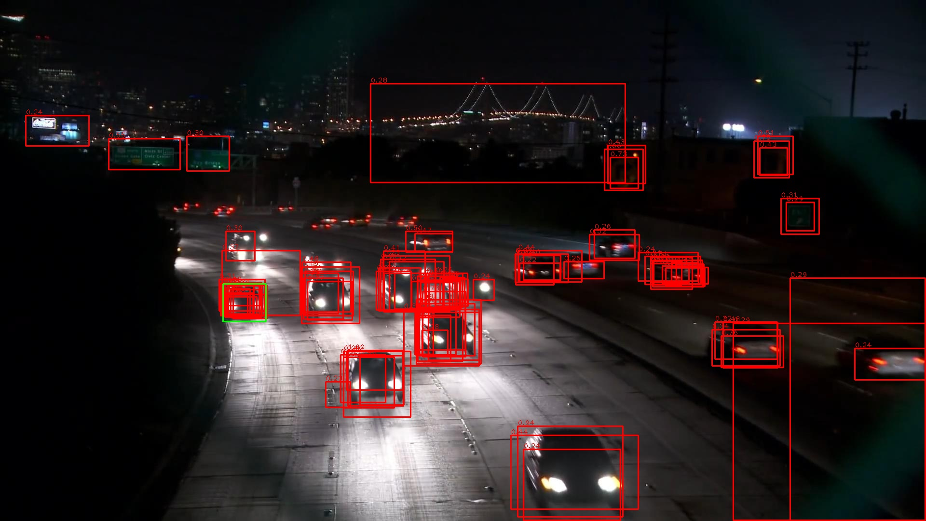
Proposals of Baseline QG-RPN
Below shows the top 100 proposals of QG-RPN output.

Slide 13

Feature Map of ResNet50
Instead of using the SOT pretrained baseline model, I load the COCO pretrained ResNet backbone, and conv the template with the image.

Slide 14

Feature Map of ResNet50
The output is different with the baseline backbone, which is pretrained on SOT datasets.

Slide 15

Feature Map of ResNet50
The output is different with the baseline backbone, which is pretrained on SOT datasets.

Slide 16
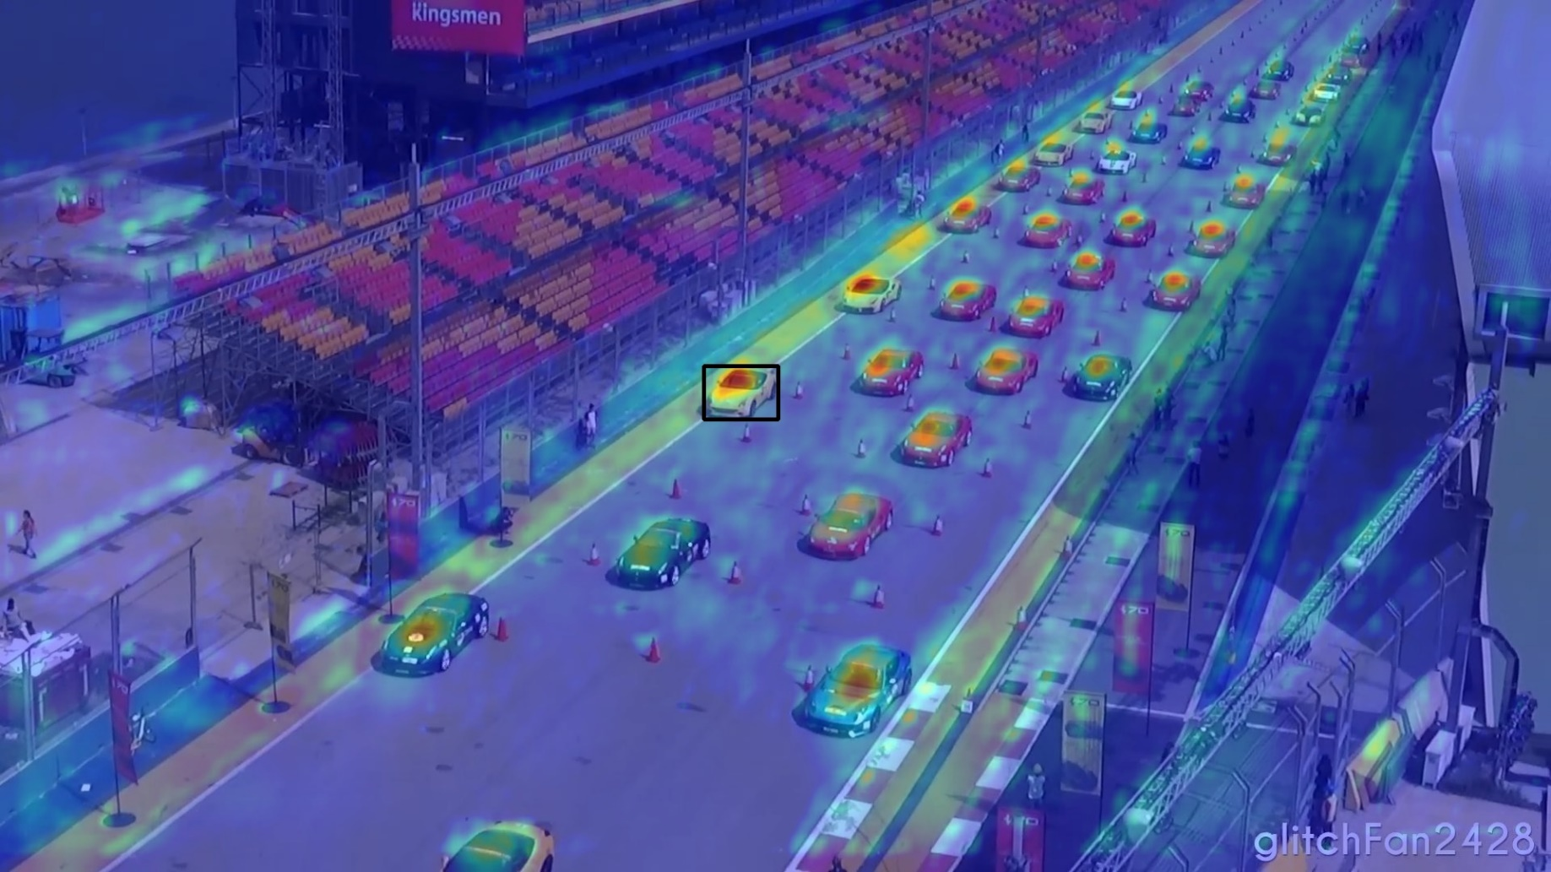
Feature Map of ResNet50
The output is different with the baseline backbone, which is pretrained on SOT datasets.

Slide 17
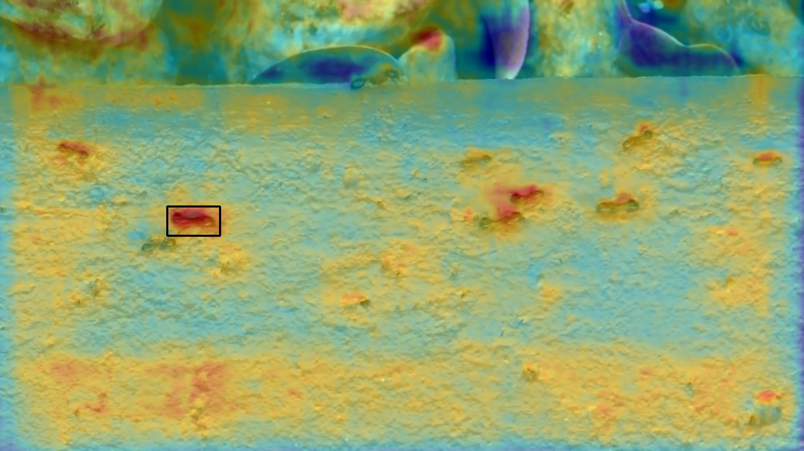
Feature Map of ResNet50
The output is different with the baseline backbone, which is pretrained on SOT datasets.

Slide 18

Feature Map of Swin-S
To see the influence of backbones, I also loaded the COCO pretrained Swin-S backbone, and conv the template with the image.

Slide 19

Feature Map of Swin-S
Swin > ResNet for some sequences, but ResNet > Swin in other sequences.

Slide 20

Feature Map of Swin-S
Swin > ResNet for some sequences, but ResNet > Swin in other sequences.

Slide 21
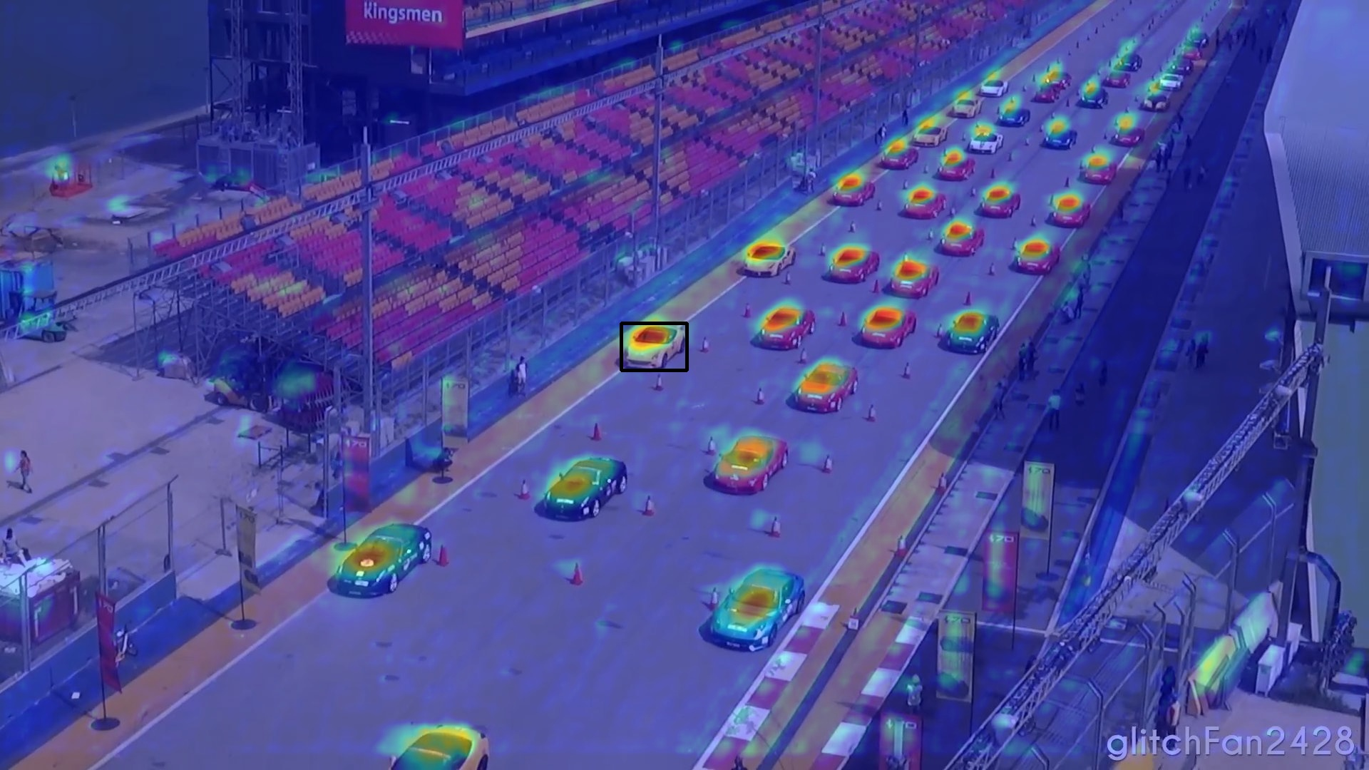
Feature Map of Swin-S
Below shows one example that Swin > ResNet.

Slide 22
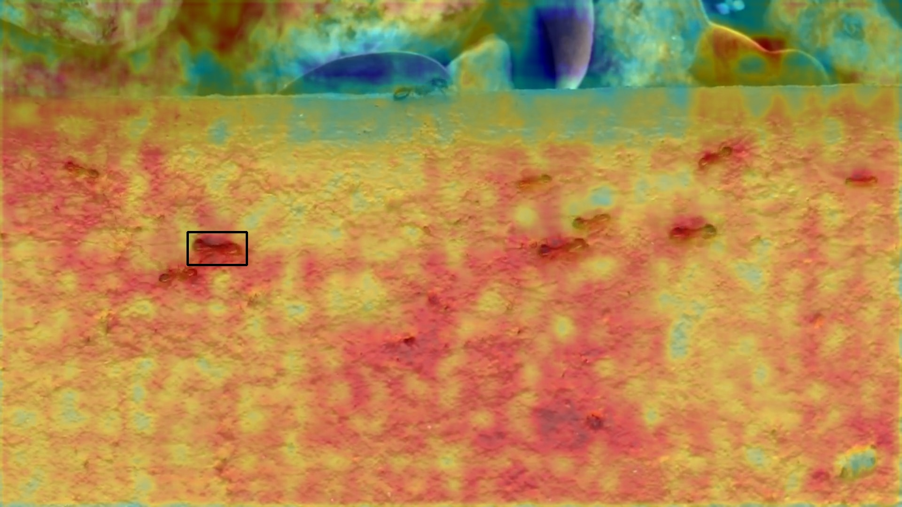
Feature Map of Swin-S
Below shows one example that ResNet > Swin.

Slide 23
End
End and Thanks!

